Slide 1
Cyberspace
Cyberspace can be defined as an intricate environment that involves interactions between people, software, and services.
It is maintained by the worldwide distribution of information and communication technology devices and networks.
With the benefits carried by the technological advancements, the cyberspace today has become a common pool used by citizens, businesses, critical information infrastructure, military and governments in a fashion that makes it hard to induce clear boundaries among these different groups.
The cyberspace is anticipated to become even more complex in the upcoming years, with the increase in networks and devices connected to it.

Slide 2
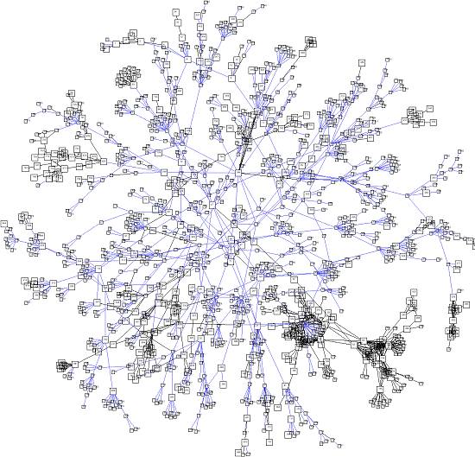
Concept of Cyberspace
Cyberspace
Cyberspace is "the environment in which communication over computer networks occurs.“
And almost everybody in one way or the other is connected to it
Cyber space includes computers, networks, software's, data storage devices (such as hard disks, USB disks etc), the Internet, websites, emails and even electronic devices such as cell phones, ATM machines etc.

Slide 3




Concept of Cyberspace
Shepherds are connected to locate their cattle
Hunters are connected to it to locate their prey
Our friend, the farmer is connected to it and “Facebooking” in the coconut tree
Our friends in the remote areas are also connected to it

Slide 4
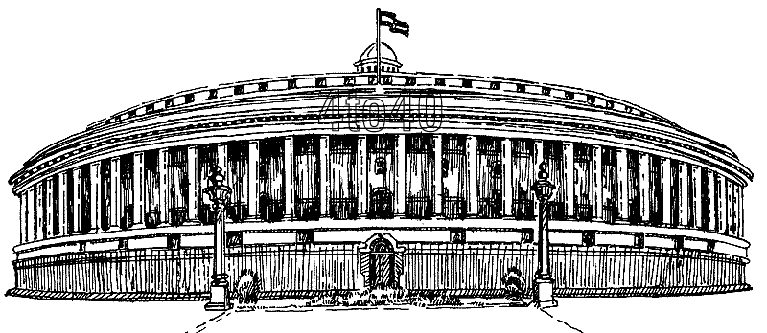




Concept of Cyberspace
Law makers
Government
Judiciary

Slide 5




Health Sectors
Transportation Sectors

Slide 6
Cyberspace is the dynamic and virtual space
In 1984, Wiliam Gibson published his science fiction book – Necromancer, which describes an online world of computers and elements of the society who use these computers. The word cyberspace first appeared in this book. In the book, a hacker of databases stole data for a fee. The author portrayed cyberspace as a three-dimensional virtual landscape. Also, a network of computers creates this space.
According to him, cyberspace looked like a physical space but was actually a computer generated construction.
It simply represents the interconnected space between computers, systems, and other networks.
It exists in the form of bits and bytes – zeroes and ones (0’s and 1’s). In fact, the entire cyberspace is a dynamic environment of 0’s and 1’s which changes every second. These are simply electronic impulses. Also, it is an imaginary location where the words of two parties meet in conversation.

Slide 7
Cyberspace vs. Physical World
Firstly, cyberspace is a digital medium and not a physical space. It is an interactive world and is not a copy of the physical world. Here are some differences between cyberspace and the physical world:
Physical World Cyberspace
Static, well-defined, and incremental Dynamic, undefined, and exponential
Has fixed contours Is as vast as the human imagination and has no fixed shape
In a human brain, there are countless neurons which create a spectre of life. Similarly, the cyberspace represents millions of computers creating a spectre of digital life. Therefore, cyberspace is a natural extension of the physical world into an infinite world.

Slide 8
Cyber Law ?
Cyber Law is the law governing cyber space.
Cyber Law is a generic term referring to all the legal and regulatory aspects of the internet. Everything concerned with or related to or emanating from any legal aspects or concerning any activities of the citizens in the cyberspace comes within the ambit of cyber laws.

Slide 9
Cyber Law Deals with
Cyber Crimes
Electronic or Digital Signatures
Intellectual Property
Data Protection and Privacy

Slide 10
Need of Cyber Law
"The modern thief can steal more with a computer than with a gun. Tomorrow's terrorist may be able to do more damage with a keyboard than with a bomb".
National Research Council, U S A "Computers at Risk”.1991

Slide 11
Need of Cyber Law
Internet has dramatically changed the way we think, the way we govern, the way we do commerce and the way we perceive ourselves.
Information technology is encompassing all walks of life all over the world.
Cyber space creates moral, civil and criminal wrongs. It has now given a new way to express criminal tendencies.

Slide 12
Need of Cyber Law
Cyberspace is open to participation by all
“IT” has brought Transition from paper to paperless world
The laws of real world cannot be interpreted in the light of emerging cyberspace to include all aspects relating to different activities in cyberspace
Internet requires an enabling and supportive legal infrastructure in tune with the times

Slide 13
The India Cyber Space - IT Act-2000
The Information Technology Act, 2000 (IT Act), came
into force on 17 October 2000.
The primary purpose of the Act is to provide legal recognition to electronic commerce and to facilitate filing of electronic records with the Government.
Information Technology Act 2000 consisted of
94 sections segregated into 13 chapters.

Slide 14
IT Act-2000 : Objectives
To provide legal recognition for transactions
To facilitate electronic filing of documents with the Government agencies.
To amend the Indian Penal Code, The Indian Evidence Act, 1872, The Banker's Book Evidence Act, 1891 and the Reserve Bank of India Act, 1934.
Aims to provide the legal framework to all
electronic records.

Slide 15
IT Act-2000
Snapshot of Important Cyber Law Provisions in India
Offence Section under IT Act
Tampering with Computer source documents (with out the permission of in charge)
Sec.43
Hacking with Computer systems, Data alteration
Sec.66
Publishing obscene information
Sec.67
Un-authorized access to protected system
Sec.70
Breach of Confidentiality and Privacy
Sec.72
Publishing false digital signature certificates
Sec.73

Slide 16
IT Act-2000
Crimes under Indian Penal Code and Special Laws
Offence Sections
Sending threatening & Defamatory messages by email Sec 503 & 499 IPC Forgery of electronic records Sec 463 IPC
Bogus websites, cyber frauds Sec 420 IPC
Email spoofing & Abuse Sec 463 & 500 IPC
Web-Jacking Sec 383 IPC
Online sale of Drugs NDPS Act
Online sale of Arms Arms Act

Slide 17


Section 43
If any person uses a computer or system network without permission of the owner or any other person who is incharge &
Access, download, Copy any data from such computer
Introduces Computer Virus into any computer.
Damages any computer network or computer.
Changes Account Settings.
Punishment
He shall be liable to pay damages by the way of
compensation not exceeding 1 Crore to affected person.
19

Slide 18
Section 66
Hacking with Computer System
Information residing in a computer resources must be
either:
Destroyed
Deleted
Altered
Diminished in value or utility
Affected Injuriously
Punishment
3 yrs. Or Fine up to 2 lakh.
20

Slide 19
Section 67
Publication or transmitted in the electronic form any material which contains sexually explicit acts or conduct.
Punishment
1st conviction with 2 to 5 years of imprisonment and fine of 1 lakh rupees.
2nd or subsequent conviction with the imprisonment up to 7-10 years and also with fine which may extend to 10 lakh rupees.
21

Slide 20
Some other Sections
Section 65 : Tampering with computer source document.
Punishments
Offences are punishable with imprisonment up to 3 yrs.
And/or fine up to Rs. 2 lakh.
Section 69: Interception, monitoring of any information regarding the integrity, Security or defense of India, friendly relations with foreign countries. Punishment
2 lakh and /or jail not extending 5 yrs
22

Slide 21
Some other Sections
Section 502A: Publishing, Transmitting images of the private area of a person without his or her consent.
Punishment : 2yrs./2 lakh.
Section 419A: Cheating by any communication device or
computer resource
Punishment : 5yrs.
Section 417A: Identity Theft
Punishment: 2yrs.
Section 72: Violation of the privacy policy Punishment: Fine up to 5 lakh jail not extending 2 yrs.

Slide 22
IT Act Amendment-2008
The Information Technology Amendment Act, 2008 (IT
Act 2008) has been passed by the parliament on
23rd December 2008.
It received the assent of President of India on
5th February, 2009.
The IT Act 2008 has been notified on October 27, 2009.

Slide 23
IT Act Amendment-2008
ITA-2008, is a new version of IT Act 2000.
Provides additional focus on Information Security.
Added several new sections on offences
including Cyber Terrorism and Data Protection.
124 sections and 14 chapters.
Schedule I and II have been replaced & Schedules III and IV are deleted.

Slide 24
Salient features
Digital signature has been replaced with Electronic
signature.
Section 67 of the old Act is amended.
Sections 66A to 66F prescribe punishment for obscene electronic message transmissions
& cyber terrorism.

Slide 25
Salient features
Amended section 69 gives power to the state.
Sections 69 A and B, grant power to the state to direct blocking for public access of any information through any computer resource.

Slide 26
SOPA & PIPA
United States America have many rules to regulate
internet content, Currently He is working on :
SOPA (Stop Online Piracy) is a United States bill to expand the ability to fight online trafficking in copyrighted intellectual property.
PIPA (Protect IP Act) is a proposed law of U.S. government.

Slide 27
World & Cyber laws
The Great firewall of China monitors every movement in cyber space and protect to publish any offensive content.
China have a hold on every content which is harmful of
dangerous for the government of China.
Brazil is considered world’s biggest airport for Hackers.
Iran is also a dangerous country for the Netizens. He also have a Crime Police unit for crime in Cyber Space.

Slide 28
Importance of Cyber Law
We are living in highly digitalized world.
All companies depend upon their computer networks and keep their valuable data in electronic form.
Government forms including income tax returns, company law forms etc are now filled in electronic form.
Consumers are increasingly using credit cards for shopping.

Slide 29
Importance of Cyber Law
Most people are using email, cell phones and SMS messages for communication.
Even in "non-cyber crime" cases, important evidence is found in computers /cell phones e.g. in cases of divorce, murder, kidnapping, organized crime, terrorist operations, counterfeit currency etc.
Since it touches all the aspects of transactions and activities on and concerning the Internet, the World Wide Web and Cyberspace therefore Cyber Law is extremely important.

Slide 30
Cyber Security: International regulations

Slide 31
Importance of Legal Framework
Law takes the principle of territoriality as point of departure;
Cyber security tools and targets are physical-boundary-independent;
Agreements between nations create a general common basis for cyber security measures

Slide 32
Cyber Security Legal Framework
International Agreements
EU Legal Framework
Bilateral Agreements
National law
Internal regulations

Slide 33
Development of International Law
Cyber Security is a rather new area for law*.
Over the years, the international co-operation on cybercrime has been very active and comprehensive.
The international level of consensus on criminal law has, however, not been achieved.

Slide 34
International Activities / UN
General Assembly Resolutions on:
Developments in the Field of Information and Telecommunications in the Context of International Security
Combating the Criminal Misuse of Information Technology
Creation of a Global Culture of Cybersecurity
Creation of a Global Culture of Cybersecurity and the Protection of Critical Information Infrastructures.

Slide 35
Other International Activities
ITU - Global Cybersecurity Agenda (GCA)
INTERPOL - Coordinating law-enforcement agencies and legislations
NATO - Cyber Defense Policy and Concept
G8 High Tech Group – Recommendations and Best Practices
OECD, several regional organizations

Slide 36
Council of Europe
Convention on Cybercrime (C³)
opened for signature 2001
entry into force 2004
open to MS and non-MS
46 member states

Slide 37
C³: Substantial criminal law
Article 2 – Illegal access
Article 3 – Illegal interception
Article 4 – Data interference
Article 5 – System interference
Article 6 – Misuse of devices
Article 7 – Computer-related forgery
Article 8 – Computer-related fraud
Article 9 – Offences related to child pornography
Article 10 – Offences related to infringements of copyright and related rights

Slide 38
C³: Procedural Issues
Preservation and disclosure of traffic data
Search and seizure of stored computer data
Real-time information collection
Interception of computer data
Jurisdiction issues
Extradition
Mutual assistance
24/7 Network

Slide 39
Council of Europe
Convention on the Prevention on Terrorism
opened for signature 2005
entry into force 2007
31 member states
Some observations
Soft law or insufficient number of states parties
Different views as to whether there are gaps in international law in general
Difficult to achieve additional consensus
Focus to be put on ensuring the effective implementation of the conventions

Slide 40
European Union
Directives:
Personal Data Protection
Data Retention
Electronic Communications
ISP liability
Information Society Services
Spam
Critical Infrastructure Protection*
Some observations
Focus on common market
No direct effect on national security issues
Common nominator for all Member States’ legal systems

Slide 41
European Union
Framework Decisions:
Council Framework Decision 2002/475/JHA of 13 June 2002 on combating terrorism
Council Framework Decision 2005/222/JHA of 24 February 2005 on attacks against information systems
2005/222/JHA vs C³
Article 2
Illegal access to
information systems
Article 3
Illegal system interference
Article 4
Illegal data interference
Article 2 (Illegal access)
Article 3 (System
interference)
Article 4 (Data Interference)

Slide 42
Estonian proposal
Article 7
Aggravating circumstances
New paragraph 3: All member states must take the appropriate measures to ensure that offences listed in articles 2-4, directed against critical infrastructures or disturbing the provision of public services, be punishable with criminal penalties of a maximum of at least between two and five years imprisonment.

Slide 43
More on cooperation and law
Bilateral agreements provide legal basis for mutual cooperation (investigation, prosecution, extradition etc.)
Countries with no legal coverage in the field are a good “jurisdiction shopping forum”
International discussions do not stand in court, different arguments and legal schools need to be balanced
Law is important, but secondary means in ensuring effective cyber security

Slide 44
National Security Policy
The National Cyber Security Policy 2013 aims at
(1) facilitating the creation of secure computing environment
(2) enabling adequate trust and confidence in electronic transactions and
(3) guiding stakeholders actions for the protection of cyberspace.

Slide 45
The need to protect information
National Cyber Security Policy 2013 should be seen as about protecting of information, such as personal information, financial/banking information, sovereign data etc.
Information empowers, and in order to empower people with information, we need to secure the information/data.
There is a need to distinguish between data which can freely flow and data which needs to be protected.

Slide 46
The “National Cyber Security Policy” has been prepared in consultation with all relevant stakeholders, user entities and public.
This policy aims at facilitating the creation of secure computing environment and enabling adequate trust and confidence in electronic transactions and also guiding stakeholders actions for the protection of cyberspace.
The National Cyber Security Policy document outlines a roadmap to create a framework for comprehensive, collaborative and collective response to deal with the issue of cyber security at all levels within the country.
The policy recognises the need for objectives and strategies that need to be adopted both at the national level as well as international level.

Slide 47
Vision
To build a secure and resilient cyberspace for citizens, businesses and Government
Mission
To protect information and information infrastructure in cyberspace, build capabilities to prevent and respond to cyber threats, reduce vulnerabilities and minimize damage from cyber incidents through a combination of institutional structures, people, processes, technology and cooperation.
Objectives
1) To create a secure cyber ecosystem in the country, generate adequate trust & confidence in IT systems and transactions in cyberspace and thereby enhance adoption of IT in all sectors of the economy.

Slide 48
2) To create an assurance framework for design of security policies and for promotion and enabling actions for compliance to global security standards and best practices by way of conformity assessment (product, process, technology & people).
3) To strengthen the Regulatory framework for ensuring a Secure Cyberspace ecosystem.
4) To enhance and create National and Sectoral level 24 x 7 mechanisms for obtaining strategic information regarding threats to ICT infrastructure, creating scenarios for response, resolution and crisis management through effective predictive, preventive, protective, response and recovery actions.
5) To enhance the protection and resilience of Nation’s critical information infrastructure by operating a 24x7 National Critical Information Infrastructure Protection Centre (NCIIPC) and mandating security practices related to the design, acquisition, development, use and operation of information resources.
6) To develop suitable indigenous security technologies through frontier technology research, solution oriented research, proof of concept, pilot development, transition, diffusion and commercialisation leading to widespread deployment of secure ICT products / processes in general and specifically for addressing National Security requirements.

Slide 49
7) To improve visibility of the integrity of ICT products and services by establishing infrastructure for testing & validation of security of such products.
8) To create a workforce of 500,000 professionals skilled in cyber security in the next 5 years through capacity building, skill development and training.
9) To provide fiscal benefits to businesses for adoption of standard security practices and processes.
10) To enable protection of information while in process, handling, storage & transit so as to safeguard privacy of citizen's data and for reducing economic losses due to cyber crime or data theft.
11) To enable effective prevention, investigation and prosecution of cyber crime and enhancement of law enforcement capabilities through appropriate legislative intervention.
12) To create a culture of cyber security and privacy enabling responsible user behaviour & actions through an effective communication and promotion strategy.
13) To develop effective public private partnerships and collaborative engagements through technical and operational cooperation and contribution for enhancing the security of cyberspace.
14) To enhance global cooperation by promoting shared understanding and leveraging relationships for furthering the cause of security of cyberspace.

Slide 50
Strategies
A. Creating a secure cyber ecosystem
1) To designate a National nodal agency to coordinate all matters related to cyber security in the country, with clearly defined roles & responsibilities.
2) To encourage all organizations, private and public to designate a member of senior management, as Chief Information Security Officer (CISO), responsible for cyber security efforts and initiatives.
3) To encourage all organizations to develop information security policies duly integrated with their business plans and implement such policies as per international best practices. Such policies should include establishing standards and mechanisms for secure information flow (while in process, handling, storage & transit), crisis management plan, proactive security posture assessment and forensically enabled information infrastructure.
4) To ensure that all organizations earmark a specific budget for implementing cyber security initiatives and for meeting emergency response arising out of cyber incidents.
5) To provide fiscal schemes and incentives to encourage entities to install, strengthen and upgrade information infrastructure with respect to cyber security.
6) To prevent occurrence and recurrence of cyber incidents by way of incentives for technology development, cyber security compliance and proactive actions.
7) To establish a mechanism for sharing information and for identifying and responding to cyber security incidents and for cooperation in restoration efforts.
8) To encourage entities to adopt guidelines for procurement of trustworthy ICT products and provide for procurement of indigenously manufactured ICT products that have security implications.

Slide 51
B. Creating an assurance framework
1) To promote adoption of global best practices in information security and compliance and thereby enhance cyber security posture.
2) To create infrastructure for conformity assessment and certification of compliance to cyber security best practices, standards and guidelines (Eg. ISO 27001 ISMS certification, IS system audits, Penetration testing / Vulnerability assessment, application security testing, web security testing).
3) To enable implementation of global security best practices in formal risk assessment and risk management processes, business continuity management and cyber crisis management plan by all entities within Government and in critical sectors, to reduce the risk of disruption and improve the security posture.
4) To identify and classify information infrastructure facilities and assets at entity level with respect to risk perception for undertaking commensurate security protection measures.
5) To encourage secure application / software development processes based on global best practices.
6) To create conformity assessment framework for periodic verification of compliance to best practices, standards and guidelines on cyber security.
7) To encourage all entities to periodically test and evaluate the adequacy and effectiveness of technical and operational security control measures implemented in IT systems and in networks.

Slide 52
C. Encouraging Open Standards
1) To encourage use of open standards to facilitate interoperability and data exchange among different products or services.
2) To promote a consortium of Government and private sector to enhance the availability of tested and certified IT products based on open standards.
D. Strengthening the Regulatory framework
1) To develop a dynamic legal framework and its periodic review to address the cyber security challenges arising out of technological developments in cyber space (such as cloud computing, mobile computing, encrypted services and social media) and its harmonization with international frameworks including those related to Internet governance.
2) To mandate periodic audit and evaluation of the adequacy and effectiveness of security of information infrastructure as may be appropriate, with respect to regulatory framework.
3) To enable, educate and facilitate awareness of the regulatory framework.

Slide 53
E. Creating mechanisms for security threat early warning, vulnerability management and response to security threats
1) To create National level systems, processes, structures and mechanisms to generate necessary situational scenario of existing and potential cyber security threats and enable timely information sharing for proactive, preventive and protective actions by individual entities.
2) To operate a 24x7 National Level Computer Emergency Response Team (CERT-In) to function as a Nodal Agency for coordination of all efforts for cyber security emergency response and crisis management. CERT-In will function as an umbrella organization in enabling creation and operationalization of sectoral CERTs as well as facilitating communication and coordination actions in dealing with cyber crisis situations.
3) To operationalise 24x7 sectoral CERTs for all coordination and communication actions within the respective sectors for effective incidence response & resolution and cyber crisis management.
4) To implement Cyber Crisis Management Plan for dealing with cyber related incidents impacting critical national processes or endangering public safety and security of the Nation, by way of well coordinated, multi disciplinary approach at the National, Sectoral as well as entity levels.
5) To conduct and facilitate regular cyber security drills & exercises at National, sectoral and entity levels to enable assessment of the security posture and level of emergency preparedness in resisting and dealing with cyber security incidents.

Slide 54
F. Securing E-Governance services
1) To mandate implementation of global security best practices, business continuity management and cyber crisis management plan for all e-Governance initiatives in the country, to reduce the risk of disruption and improve the security posture.
2) To encourage wider usage of Public Key Infrastructure (PKI) within Government for trusted communication and transactions.
3) To engage information security professionals / organisations to assist e-Governance initiatives and ensure conformance to security best practices.

Slide 55
G. Protection and resilience of Critical Information Infrastructure
1) To develop a plan for protection of Critical Information Infrastructure and its integration with business plan at the entity level and implement such plan. The plans shall include establishing mechanisms for secure information flow (while in process, handling, storage & transit), guidelines and standards, crisis management plan, proactive security posture assessment and forensically enabled information infrastructure.
2) To Operate a 24x7 National Critical Information Infrastructure Protection Centre (NCIIPC) to function as the nodal agency for critical information infrastructure protection in the country.
3) To facilitate identification, prioritisation, assessment, remediation and protection of critical infrastructure and key resources based on the plan for protection of critical information infrastructure.
4) To mandate implementation of global security best practices, business continuity management and cyber crisis management plan by all critical sector entities, to reduce the risk of disruption and improve the security posture.
5) To encourage and mandate as appropriate, the use of validated and certified IT products.
6) To mandate security audit of critical information infrastructure on a periodic basis.
7) To mandate certification for all security roles right from CISO / CSO to those involved in operation of critical information infrastructure.
8) To mandate secure application / software development process (from design through retirement) based on global best practices.

Slide 56
H. Promotion of Research & Development in cyber security
1) To undertake Research & Development programs for addressing all aspects of development aimed at short term, medium term and long term goals. The Research & Development programs shall address all aspects including development of trustworthy systems, their testing, deployment and maintenance throughout the life cycle and include R&D on cutting edge security technologies.
2) To encourage Research & Development to produce cost-effective, tailor-made indigenous security solutions meeting a wider range of cyber security challenges and target for export markets.
3) To facilitate transition, diffusion and commercialisation of the outputs of Research & Development into commercial products and services for use in public and private sectors.
4) To set up Centres of Excellence in areas of strategic importance for the point of security of cyber space.
5) To collaborate in joint Research & Development projects with industry and academia in frontline technologies and solution oriented research.

Slide 57
I. Reducing supply chain risks
1) To create and maintain testing infrastructure and facilities for IT security product evaluation and compliance verification as per global standards and practices.
2) To build trusted relationships with product / system vendors and service providers for improving end-to-end supply chain security visibility.
3) To create awareness of the threats, vulnerabilities and consequences of breach of security among entities for managing supply chain risks related to IT (products, systems or services) procurement.
J. Human Resource Development
1) To foster education and training programs both in formal and informal sectors to support the Nation’s cyber security needs and build capacity.
2) To establish cyber security training infrastructure across the country by way of public private partnership arrangements.
3) To establish cyber security concept labs for awareness and skill development in key areas.
4) To establish institutional mechanisms for capacity building for Law Enforcement Agencies.

Slide 58
K. Creating Cyber Security Awareness
1) To promote and launch a comprehensive national awareness program on security of cyberspace.
2) To sustain security literacy awareness and publicity campaign through electronic media to help citizens to be aware of the challenges of cyber security.
3) To conduct, support and enable cyber security workshops / seminars and certifications.
L. Developing effective Public Private Partnerships
1) To facilitate collaboration and cooperation among stakeholder entities including private sector, in the area of cyber security in general and protection of critical information infrastructure in particular for actions related to cyber threats, vulnerabilities, breaches, potential protective measures, and adoption of best practices.
2) To create models for collaborations and engagement with all relevant stakeholders.
3) To create a think tank for cyber security policy inputs, discussion and deliberations.

Slide 59
M. Information sharing and cooperation
1) To develop bilateral and multi-lateral relationships in the area of cyber security with other countries.
2) To enhance National and global cooperation among security agencies, CERTs, Defence agencies and forces, Law Enforcement Agencies and the judicial systems.
3) To create mechanisms for dialogue related to technical and operational aspects with industry in order to facilitate efforts in recovery and resilience of systems including critical information infrastructure.
N. Prioritized approach for implementation
To adopt a prioritized approach to implement the policy so as to address the most critical areas in the first instance.

Slide 60
Operationalisation of the Policy
This policy shall be operationalised by way of detailed guidelines and plans of action at various levels such as national, sectoral, state, ministry, department and enterprise, as may be appropriate, to address the challenging requirements of security of the cyberspace.

Slide 61
What is Cyber Forensics?
What?
The practice of gathering, retaining, and analyzing computer-related data for investigative purposes in a manner that maintains the integrity of the data.
How?
Through the digital forensics investigation process including: Identification, Preservation, Analysis, and Presentation (IPAP).
Why? Used in criminal investigations to identify what happened, how it happened, when it happened and the people involved.

Slide 62
Relationship between Cybersecurity and Cyber Forensics
6
Cybersecurity aims to protect electronic assets from breaches; whereas, cyber forensics explains how a policy became violated and who was responsible for it.
Cyber Forensics
Cyber security
Fig. 1 Feedback cycle of Cybersecurity and Cyber Forensics

Slide 63








Edmond Locard’s Principle
Locard’s Principle - Perpetrator of a crime will bring something into the crime scene and leave with something from it, and that both can be used as forensic evidence; thus, every Cyber Fraud or Cyber Crime will have evidence.
Example:
10 people decide to go hunting and all shoot at the same deer at the same time. The group takes the deer’s life; however there is only 1 entry wound. Which hunter killed the deer?

Slide 64
Historical Background of Cyber forensics
In 1978 the State of Florida passed Fla. Stat. 815.01, the "Florida Computer Crimes Act". This law, which included legislation against the unauthorized modification or deletion of data on a computer system, and against damage to computer hardware including networks, may be the earliest American statute specifically against computer crimes. The maximum penalty for a single offense classified as a Felony of the Third Degree was:
"Up to 5 years of imprisonment and a fine of up to $5,000 or any higher amount equal to double the pecuniary gain derived from the offense by the offender or double the pecuniary loss suffered by the victim."

Slide 65
1. Computer forensics
It is the lawful and ethical seizure, acquisition, analysis, reporting and safeguarding of data and metadata derived from digital devices which may contain information that is notable and perhaps of evidentiary value to the trier of fact in managerial, administrative, civil and criminal investigations.
In other words, it is the collection of techniques and tools used to find evidence in a computer.
2. Digital forensics
It is the use of scientifically derived and proven methods toward the preservation, collection, validation, identification, analysis, interpretation, documentation and presentation of digital evidence derived from digital sources for the purpose of facilitation or furthering the reconstruction of events found to be criminal, or helping to anticipate unauthorized actions shown to be disruptive to planned operations.
1. Uncover and document evidence and leads.
2. Corroborate evidence discovered in other ways.
3. Assist in showing a pattern of events (data mining has an application here).
4. Connect attack and victim computers.
5. Reveal an end-to-end path of events leading to a compromise attempt, successful or not. Extract data that may be hidden, deleted or otherwise not directly available.

Slide 66
The typical scenarios involved are:
1. Employee Internet abuse.
2. Data leak/data breach.
3. Industrial espionage.
4. Damage assessment.
5. Criminal fraud and deception cases;
6. Criminal cases.
7. Copyright violation

Slide 67
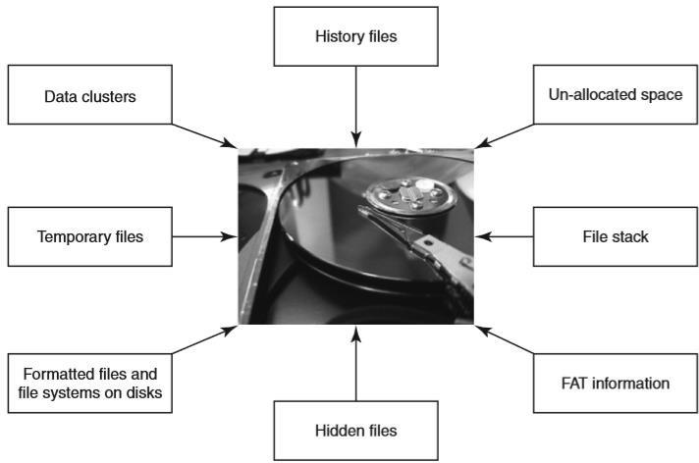
Data seen using forensics tools. FAT means file allocation table

Slide 68
Using digital forensics techniques, one can:
1. Corroborate and clarify evidence otherwise discovered.
2. Generate investigative leads for follow-up and verification in other ways.
3. Provide help to verify an intrusion hypothesis.
4. Eliminate incorrect assumptions.

Slide 69
The Need for Computer Forensics
The convergence of Information and Communications Technology (ICT) advances and the pervasive use of computers worldwide together have brought about many advantages to mankind. At the same time, this tremendously high technical capacity of modern computers/computing devices provides avenues for misuse as well as opportunities for committing crime.

Slide 70

Fig: Hidden and miniaturized storage media

Slide 71
“Fungibility” means the extent to which the components of an operation or product can be inter- changed with similar components without decreasing the value of the operation or product.
Chain of custody means the chronological documentation trail, etc. that indicates the seizure, custody, control, transfer, analysis and disposition of evidence, physical or electronic. Chain of custody is also used in most evidence situations to maintain the integrity of the evidence
Chain of Custody Concept
1. Chain of custody is the central concept in cyber forensics/digital forensics investigation.
2. The purpose of the chain of custody is that the proponent of a piece of evidence must demonstrate that it is what it purports to be.
3. The chain of custody is a chronological written record of those individuals who have had custody of the evidence from its initial acquisition until its final disposition.

Slide 72
Cyber forensics and Digital Evidence
Cyber forensics can be divided into two domains:
1. Computer forensics.
2. Network forensics.
As compared to the “physical” evidence, “digital evidence” is different in nature because it has some unique characteristics. First of all, digital evidence is much easier to change/manipulate! Second, “perfect” digital copies can be made without harming original.

Slide 73
The Rules of Evidence
It was mentioned in that the Indian IT Act amended the Indian Evidence Act. According to the “Indian Evidence Act 1872,” “Evidence” means and includes:
1. All statements which the court permits or requires to be made before it by witnesses, in relation to matters of fact under inquiry, are called oral evidence.
2. All documents that are produced for the inspection of the court are called documentary evidence.
Paper evidence, the process is clear and intuitively obvious. Digital evidence by its very nature is invisible to the eye. Therefore, the evidence must be developed using tools other than the human eye.

Slide 74
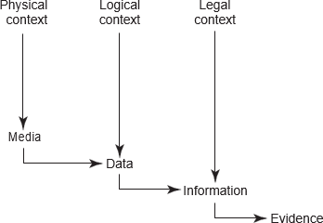
There are number of contexts involved in actually identifying a piece of digital evidence:
1. Physical context: It must be definable in its physical form, that is, it should reside on a specific piece of media.
2. Logical context: It must be identifiable as to its logical position, that is, where does it reside relative to the file system.
3. Legal context: We must place the evidence in the correct context to read its meaning. This may require looking at the evidence as machine language, for example, American Standard Code for Information Interchange (ASCII).
Fig: Path of the digital evidence.

Slide 75
Following are some guidelines for the (digital) evidence collection phase:
1. Adhere to your site’s security policy and engage the appropriate incident handling and law enforcement personnel.
2. Capture a picture of the system as accurately as possible.

Slide 76
Forensics Analysis of E-Mail
It was mentioned how criminals can use fake mails for various cybercrime offenses.
There are tools available that help create fake mails. Forensics analysis of E-Mails is an important aspect of cyber forensics analysis, it helps establish the authenticity of an E-Mail when suspected.
Mail server software is a network server software that controls the flow of E-Mail and the mail client software helps each user read, compose, send and delete messages.
E-Mail tracing is done by examining the header information contained in E-Mail messages to determine their source.

Slide 77
Digital Forensics Life Cycle
As per FBI’s (Federal Bureau of Investigation) view, digital evidence is present in nearly every crime scene. That is why law enforcement must know how to recognize, seize, transport and store original digital evidence to preserve it for forensics examination.
1. Is admissible.
2. Is authentic.
3. Is complete.
4. Is reliable.
5. Is understandable and believable.
Let us now understand what is involved in the digital forensics process.

Slide 78
The Digital Forensics Process
The digital forensics process needs to be understood in the legal context starting from preparation of the evidence to testifying. Digital forensics evidence consists of exhibits, each consisting of a sequence of bits, presented by witnesses in a legal matter to help jurors establish the facts of the case and support or refute legal theories of the case.

Slide 79
Digital Forensics Investigation Process Model
8
Presentation
Examination Analysis
Preservation
Collection
Identification
In lab
At crime scene

Slide 80
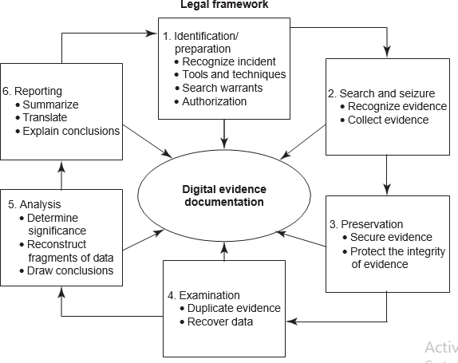
Fig: Process model for understanding a seizure and handling of forensics evidence legal framework.

Slide 81
The Phases in Computer Forensics/Digital Forensics
The investigator must be properly trained to perform the specific kind of investigation that is at hand.
Tools that are used to generate reports for court should be validated.
There are many tools to be used in the process.
One should determine the proper tool to be used based on the case. Broadly speaking, the forensics life cycle involves the following phases:
1. Preparation and identification : Case briefings engagement terms, interrogatories, spoliation prevention, disclosure and discovery planning, discovery requests.
2. Collection and recording : Drive imaging, indexing, profiling, search plans, cost estimates, risk analysis.
3. Storing and transporting
4. Examination/investigation : Triage images, data recovery, keyword searches, hidden data review, communicate, iterate
5. Analysis, interpretation and attribution
6. Reporting : Oral vs. written, relevant document production, search statistic reports, chain of custody reporting, case log reporting
7. Testifying: Testimony preparation, presentation preparation, testimony.
To mention very briefly, the process involves the following activities:

Slide 82
Preparing for the Evidence and Identifying the Evidence
Collecting and Recording Digital Evidence
Digital evidence can be collected from many sources. Obvious sources include computers, cell phones, digital cameras, hard drives, CD-ROM, USB memory devices and so on. Non-obvious sources include settings of digital thermometers, black boxes inside automobiles, RFID tags and webpages (which must be preserved as they are subject to change).

Slide 83
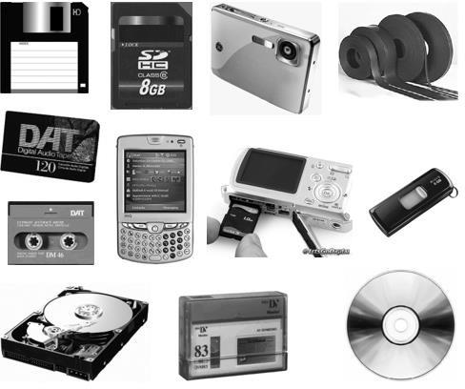
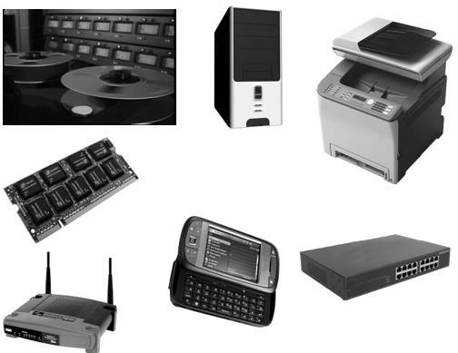
Fig: Media that can hold digital evidences

Slide 84
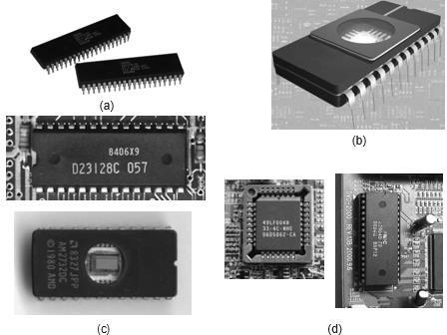
Storing and Transporting Digital Evidence
The following are specific practices that have been adopted in the handling of digital evidence:
1. Image computer media using a write-blocking tool to ensure that no data is added to the suspect device;
2. establish and maintain the chain of custody.
Fig: Embedded memories inside computer. (a) Read-only memory (ROM) chips; (b) erasable programmable read-only memory (EPROM) chip; (c) programmable read-only memory (PROM) chips; (d) electrify erasable programmable read-only memory (EEPROM) chips.

Slide 85
Some of the most valuable information obtained in the course of a forensics examination will come from the computer user. An interview with the user can yield valuable information about the system configuration, applications, encryption keys and methodology. Forensics analysis is much easier when analysts have the user’s passphrases to access encrypted files, containers and network servers. As a general rule, one should not examine digital information unless one has the legal authority to do so. Amateur forensics examiners should keep this in mind before starting any unauthorized investigation.
For the purpose of digital evidence examination, “imaging of electronic media” (on which the evidence is believed to be residing) becomes necessary.
Analysis, Interpretation and Attribution
Analysis, interpretation and attribution of evidence are the most difficult aspects encountered by most forensics analysts. In the digital forensics arena, there are usually only a finite number of possible event sequences that could have produced evidence.
Examples of common digital analysis types include:
1. Media Analysis
2. Media Management Analysis
3. File System Analysis
4. Application Analysis
5. Network Analysis
6. OS Analysis
7. Executable Analysis
8. Image Analysis
9. Video Analysis

Slide 86
Reporting
The following are the broad-level elements of the report
1. Identity of the reporting agency
2. Case identifier or submission number
3. Case investigator
4. Identity of the submitter
5. Date of receipt
6. Date of report
7. Descriptive list of items submitted for examination, including serial number, make and model
8. Identity and signature of the examiner
9. Brief description of steps taken during examination, such as string searches, graphics image searches and recovering erased files
10. Results/conclusions.

Slide 87
Testifying / Presentation
This phase involves presentation and cross-examination of expert witnesses. Depending on the country and legal frameworks in which a cybercrime case is registered, certain standards may apply with regard to the issues of expert witnesses.
Network Forensics
Network forensics professionals need to understand how wireless networks work and the fundamentals of related technology.
Wireless forensics is a discipline included within the computer forensics science, and specifically, within the network forensics field. The goal of wireless forensics is to provide the methodology and tools required to collect and analyze (wireless) network traffic that can be presented as valid digital evidence in a court of law.

Slide 88
Approaching a Computer Forensics Investigation
From the discussion so far, we can appreciate that computer forensics investigation is a detailed science.
The phases involved are as follows:
1. Secure the subject system (from tampering or unauthorized changes during the investigation);
2. take a copy of hard drive/disk (if applicable and appropriate);
3. identify and recover all files (including deleted files);
4. access/view/copy hidden, protected and temp files;
5. study “special” areas on the drive (e.g., the residue from previously deleted files);
6. investigate the settings and any data from applications and programs used on the system;
7. consider the system as a whole from various perspectives, including its structure and overall contents;
8. consider general factors relating to the user’s computer and other activity and habits in the context of the investigation;
9. create detailed and considered report, containing an assessment of the data and information collected.

Slide 89
Typical Elements Addressed in a Forensics Investigation Engagement Contract
1. Authorization
2. Confidentiality
3. Payment
4. Consent and acknowledgment
5. Limitation of liability
Laboratory responsible for any accidental damages to the data or equipment in its possession including but not limited to surface scratches, deformations and cracks.
1. Customer’s representation: Customer needs to warrant the forensics laboratory that he/she is the owner of, and/or has the right to be in possession of, all equipment/data/media furnished to the laboratory and that collection, possession, processing and transfer of such equipment/data/media are in compliance with data protection laws to which customer is subject to.
2. Legal aspects/the law side: Both the parties need to agree that the agreement shall be governed by prevailing law in every particular way including formation and interpretation and shall be deemed to have been made in the country where the contract is signed.

Slide 90
3. Data protection: The computer forensics laboratory (engaged in the investigation) will hold the information that the customer has given verbally, electronically or in any submitted form for the purpose of the forensics investigation to be carried out as per contracted services from the forensics laboratory.
4. Waiver/breach of contract: The waiver by either party of a breach or default of any of the provisions on this agreement by either party shall not be construed as a waiver of any succeeding breach of the same or other provisions, nor shall any delay or omission on the part of either party to exercise or avail itself of any right, power or privilege that it has, or may have hereunder operates as a waiver of any breach or default by either party.

Slide 91
Solving a Computer Forensics Case
1. Prepare for the forensics examination.
2. Talk to key people to find out what you are looking for and what the circumstances surrounding the case are.
3. If you are convinced that the case has a sound foundation, start assembling your tools to collect the data in question. Identify the target media.
4. Collect the data from the target media. You will be creating an exact duplicate image of the device in question. To do this, you will need to use an imaging software application like the commercial in Case or the open-source Sleuth Kit/Autopsy.
5. To extract the contents of the computer in question, connect the computer you are investigating to a portable hard drive or other storage media and then boot the computer under investigation according to the directions for the software you are using.
6. When collecting evidence, be sure to check E-Mail records as well. Quite often, these messages yield a great deal of information.
7. Examine the collected evidence on the image you have created. Document anything that you find and where you found it.
8. Analyze the evidence you have collected by manually looking into the storage media and, if the target system has a Windows OS, check the registry.
9. Report your findings back to your client. Be sure to provide a clear, concise report; this report may end up as evidence in a court case.

Slide 92
Setting up a Computer Forensics Laboratory Understanding the Requirements
There are four broad types of requirements, namely, the physical space, the hardware equipment, the software tools and the forensics procedures to be followed to aid those involved in the cybercrime investigation.

Slide 93
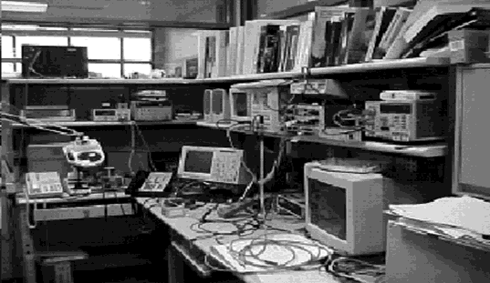
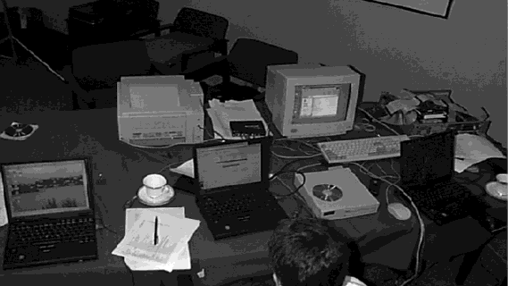
Fig: Cyber forensics laboratory – 1 Fig: Cyber forensics laboratory – 2

Slide 94
Apart from the physical space requirement, another key requirement for a computer forensics laboratory is the hardware items. The laboratory requires a number of computers, including a network server with a large storage capacity (preferably configured for the standard removable hard drives).

Slide 95
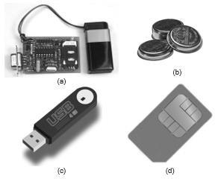
Fig: (a) SIM card reader, (b) iButtons, (c) flash memory, (d) SIM card.

Slide 96
On the software side, there are several requirements for setting up a forensics laboratory. The standard forensics software package, such as EnCase, Web Case, Forensics Tool Kit, Password Recovery Tool Kit, etc. are expensive products.
The main issues that are attacked when evidence is presented in a court of law are credentials and methodology. In some countries, the court may prefer the forensics evidence from government appointed and/or neutral party laboratories rather than the evidence from private agencies where opportunities for manipulation / exploitation are perceived.
Computer Forensics and Steganography
Steganography is the art of information hiding. The threat raised by steganography is very real. Its use is not easy to detect or intercept, as the information does not need to be broadcast across the Internet. the hidden message can reside unsuspectingly on a website, for example, and can be viewed from around the world.
Steganography is the art of information hiding. The threat raised by steganography is very real. Its use is not easy to detect or intercept, as the information does not need to be broadcast across the Internet. The hidden message can reside unsuspectingly on a website, for example, and can be viewed from around the world.
Rootkits
The term rootkit is used to describe the mechanisms and techniques whereby malware including viruses, Spyware and Trojans attempt to hide their presence from Spyware blockers, antivirus and system management utilities

Slide 97
Information Hiding
Relevance of the OSI 7 Layer Model to Computer Forensics
The OSI 7 Layer Model is useful from computer forensics perspective because it addresses the network protocols and network communication processes. The basic familiarity with the OSI 7 Layer Model is assumed for the discussion in this section.

Slide 98
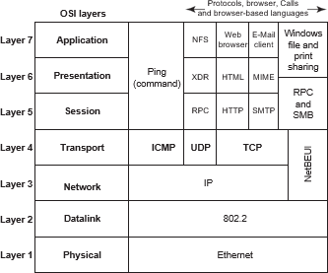
Fig: The OSI 7 Layer Model with Internet Protocols.

Slide 99
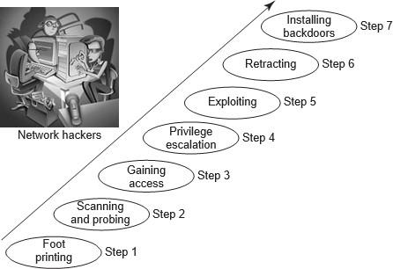
Fig: Network hacking steps

Slide 100
Step 1: Foot Printing
Foot printing includes a combination of tools and techniques used to create a full profile of the organization’s security posture. These include its domain names, IP addresses and network blocks.
Step 2: Scanning and Probing
The hacker will typically send a ping echo request packet to a series of target IP addresses. As a result of this exploratory move by the hacker, the machines assigned to one of these IP address will send out echo response thereby confirming that there is a live machine associated with that address.
Similarly, a TCP scan sends a TCP synchronization request to a series of ports and to the machines that provide the associated service to respond.

Slide 101
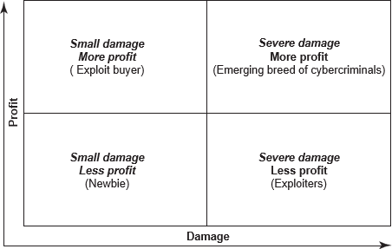
Fig. Hacker categories (profit and damage).

Slide 102
Step 3: Gaining Access
The hacker’s ultimate goal is to gain access to your system so that he/she can perform some malicious action, such as stealing credit card information, downloading confidential files or manipulating critical data.
Step 4: Privilege
When a hacker gains access to the system, he will only have the privileges granted to the user or account that is running the process that has been exploited.
Step 5: Exploit
Gaining root access gives the hacker full control on the network. Every hacker seems to have his/her own reasons for hacking. Some hackers do it for fun or a challenge, some do it for financial gain and others do it to “get even”.
Step 6: Retracting
There are many reasons that drive cybercriminals to hacking.
Step 7: Installing Backdoors
Finally, most hackers will try creating provisions for entry into the network/hacked system for later use. this, they will do by installing a backdoor to allow them access in the future.

Slide 103
Computer Forensics from Compliance Perspective
With the rampant use of the Internet, there is so much at stake; corporate data is not safe anymore given that almost all information assets lie on the corporate networks. We are in the era of Net-centric digital economy.
Criminals can gather small pieces about you, about your confidential data to generate what is known as “digital persona,” that is, they keep track about your Internet activities, what resides on your corporate networks, etc.
The Regulatory Perspective for Forensics at the International Level
These laws/regulations specify investigation and response to security breaches or policy violations. Computer forensics makes it easier to meet these requirements.

Slide 104
These laws/legislations become relevant in the context of forensics with cybercrimes.
1. The Sarbanes Oxley Act (SOX): The Act was enacted to fight corporate fraud.
2. California SB 1386
3. Gramm-Leach Bliley Act (GLBA)
The Safeguards Rule of GLB calls for financial institutions to:
a) Ensure the security and confidentiality of customer information;
b) Protect against any anticipated threats or hazards to the security or integrity of such information;
c) Protect against unauthorized access to or use of such information that could result in substantial harm or inconvenience to any customer.
4. HIPAA (Health Insurance Portability and Accountability Act of 1996)
HIPAA has the primary goal for healthcare providers to improve the privacy and security of their clients’ medical information.
Fig: Traditional approach to forensics analysis. *denotes tools/devices mentioned

Slide 105
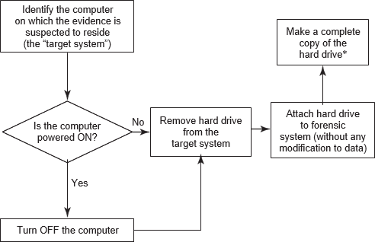

Slide 106
Forensics Investigation
The basic steps to a forensics investigation are as follows:
1.Prepare—Specific forensics training, overarching corporate policies and procedures, as well as practice investigations and examinations will prepare you for an “event.” Specialized forensics or incident handling certifications are considered of great value for forensics investigators.
2.Identify—When approaching an incident scene—review what is occurring on the computer screen. If data is being deleted, pull the power plug from the wall; otherwise perform real-time capture of system “volatile” data first.
3.Preserve—Once the system-specific “volatile” data is retrieved, then turn off machine, remove it from scene, and power it up in an isolated environment. Perform a full system bit-stream image capture of the data on the machine, remembering to “hash” the image with the original data for verification purposes.
4.Select —Once you have a verified copy of the available data, start investigation of data by selecting potential evidence files, datasets, and locations data could be stored. Isolate event-specific data from normal system data for further examination.

Slide 107
5.Examine—Look for potential hidden storage locations of data such as slack space, unallocated space, and in front of File Allocation Table (FAT) space on hard drives. Remember to look in registry entries or root directories for additional potential indicators of data storage activity.
6.Classify—Evaluate data in potential locations for relevance to current investigation. Is the data directly related to case, or does it support events of the case, or is it unrelated to the case?
7.Analyze—Review data from relevant locations. Ensure data is readable, legible, and relevant to investigation. Evaluate it for type of evidence: Is it direct evidence of alleged issue or is it related to issue?
8.Present—Correlate all data reviewed to investigation papers (warrants, corporate documents, etc.). Prepare data report for presentation—either in a court of law or to corporate officers.

Slide 108
Challenges of Computer Forensics
A microcomputer may have 60-GB or more storage capacity.
There are more than 2.2 billion messages expected to be sent and received (in US) per day.
There are more than 3 billion indexed Web pages world wide.
There are more than 550 billion documents on line.
Exabytes of data are stored on tape or hard drives.
(Source: Marcella, Albert, et al, Cyber Forensic, 2002.)

Slide 109
Challenges of Computer Forensics (continued)
How to collect the specific, probative, and case-related information from very large groups of files?
Link analysis
Visualization
Enabling techniques for lead discovery from very large groups of files:
Text mining
Data mining
Intelligent information retrieval

Slide 110
Challenges of Computer Forensics (continued)
Computer forensics must also adapt quickly to new products and innovations with valid and reliable examination and analysis techniques.

Slide 111
FORENSIC AUDIT

Slide 112
WHAT IS FORENSIC AUDIT ?
A forensic audit, refers to the application of accounting methods for detection and gathering evidence of frauds, embezzlement, or any other such white-collar crime.
It is an examination of a company’s financial records to derive evidence which can be used in a court of law or legal proceeding.
The failure of some formerly prominent public companies such as Enron, WorldCom, Xerox Corporation and Satyam Computer Services fueled the prominence of forensic auditing

Slide 113

FORENSIC AUDITORS
They are retained by banks, courts, business communities, police forces, lawyers, insurance companies, government regulatory bodies and organizations.
Highly specialized
Scrutiny of the options
Effective listener
Knowledge of techniques and law

Slide 114
HOW IS FORENSIC AUDIT INVESTIGATION CONDUCTED ?
Accepting the
investigation
Planning the
investigation
Perform the analysis
Gathering the evidence
Reporting
Court Proceedings

Slide 115
Step 1 – Accepting the Investigation
The firm must ascertain whether or not they have the necessary tools, skills and expertise to go forward with such an investigation. They need to do an assessment of their own training and knowledge of fraud detection and legal framework
Step 2 – Planning the Investigation
The auditor(s) must carefully ascertain the goal of the audit so being conducted, and to carefully determine the procedure to achieve it, through the use of effective tools and techniques. Planning also includes the identification of the best mode to gather evidence.

Slide 116
Step 3 – Gathering the evidence
In forensic auditing specific procedures are carried out in order to produce evidence. The investigators can use the following techniques to gather evidence :
Testing controls which identifies the weaknesses,
Using analytical procedures to compare trends over time
Applying computer-assisted audit techniques,
Discussions and interviews with employees
Substantive techniques such as reconciliations, cash counts and reviews of documentation.

Slide 117
Step 4 – Perform the analysis
The actual analysis performed may involve calculating economic damages, summarizing a large number of transactions, tracing of assets, present value considerations
Step 5 – Reporting
After investigating and gathering evidence, the investigating team is expected to give a report of the findings of the investigation, and also the summary of the evidence and conclusion about the loss suffered due to the fraud.
Step 6 – Court Proceedings
The last stage expands over those audits that lead to legal proceedings. The auditors are called to the Court, and also included in the advocacy process.

Slide 118

TYPES OF INVESTIGATIONS UNDER FORENSIC
AUDIT
Asset Misappropriation
This includes misappropriation of cash, raising fake invoices, payments made to non-existing suppliers or employees
It happens when people who are entrusted to manage the assets of an organization, steal from it.
The direct hit is on the cash flow of the organization.

Slide 119

TYPES OF INVESTIGATIONS UNDER FORENSIC
AUDIT
Corruption
Corruption is a major obstacle at corporate levels, and also to socio- economic development. It can surface in various forms such as -
Bribery
Extortion
Conflict of interest

Slide 120

TYPES OF INVESTIGATIONS UNDER FORENSIC
AUDIT
Financial Statement Fraud (FSF)
Financial statement fraud is the deliberate misrepresentation, misstatement or omission of data for the purpose of misleading the reader and creating a false impression of an organization’s financial strength.
The common practice is deferring revenues or expense in a different time period to give the appearance of consistent earnings or growth.

Slide 121

SATYAM CASE
7561 fake invoices
Inflated receivables
Fake Fixed Deposit Receipts were printed
Bank guarantees were manipulated
Fake bank balance statements of BNP Paribas, HSBC, ICICI Bank and Citibank

Slide 122
FORENSIC AUDIT TECHNIQUES
General Audit Techniques
Testing defenses - A good forensic audit technique is to attempt to circumvent these defenses yourself. This technique requires you to put yourself in the shoes of the suspect and think accordingly.
Statistical and Mathematical Techniques
Trend Analysis - Careful review of the historical norms
Ratio Analysis – Analysis of ratios report on the fraud health by identifying the possible symptoms of the fraud.

Slide 123
FORENSIC AUDIT TECHNIQUES
Technology based/ digital forensic techniques
Every transaction leaves a digital footprint in the computer driven society. Many digital enabled forensic tools are available to assist the auditor such as –
cross drive analysis, live analysis, Encase, MD5, Tracking log files, PC system log, Steganography, Free log tools.
Computer aided audit tools (CAATs)
It is the practice of using computers to automate the IT audit processes. The CAAT tool supports the forensic accounting in which larger amount can be diverted to the analytical form and it also prompts where the tool detects the fraud..

Slide 124

FORENSIC AUDIT TECHNIQUES
Data Mining
Data mining is an analysis process used to examine data sets or metadata to identify patterns, anomalies, and trends to answer business queries and provide predictive value for future events. It incorporates algorithms to explore, analyze, classify, relate, and partition data sets

Slide 125
FORENSIC AUDIT TECHNIQUES
Software and tools
Generalized audit software is a category of CAAT to undertake data extraction, summarization and analytical skills. Currently the latest version of generalized audit software includes the audit command language, interactive data extraction and analysis (IDEA) and Panaudit .
Due to the shortcomings of generalized audit software, common software tools have become more popular over the time period. Spreadsheets like Ms Excel, Lotus etc, RDBMS like MsAccess etc and report writers like Crystal reports etc are few examples of CST.

Slide 126

FORENSIC AUDIT IN THE CURRENT SCENARIO

Slide 127
FORENSIC AUDIT IN THE NIRAV MODI CASE
A staggering 30 banks will be a part of the forensic audit, besides Punjab National Bank, to trace and track the chain of money movement
It eventually ended up as a gigantic Rs 11,400 crore
Indian banking fraud.
Its outcome will be used as evidence in court to prosecute the key perpetrator Nirav Modi and his firms and Mehul Choksi, promoter, Gitanjali Group.

Slide 128

RBI GUIDELINES
As per RBI’s master direction on frauds, revised in
July 2017,
In case an account is classified as a fraud and falls under multiple banking arrangements, the account should be red flagged by all banks, initiate a forensic audit and lodge complaints with the CBI and law enforcement agencies.
This process should be completed within six
months.

